Slide 1
SMART GARDENING SYSTEM AND ITS MONITORING

Slide 2
PROBLEM DEFINITION
Gardening is a common hobby for nature lovers. But the plants need continuous care. Sometimes, they may not get correct amount of water due to our carelessness. Like when the owner of the garden needs to go somewhere for a while due to business work or other things, the garden may remain unchecked and unwatered for quite some time. The IOT can offer a solution to this problem for monitoring and watering via the smart gardening system. The garden can be modernized with recent technology which can be continuously monitored, so the plants could be provided watering and enough light according to need

Slide 3
PROBLEM DEFINITION
In our project, smart gardening system and its monitoring using iot is designed. An IoT device built on Arduino UNO and sensors like Moisture sensor and LDR light sensor is made which updates the sensor readings to Thing Speak in particular amount of times. It Is an IoT platform for visualising data in different formats by connecting to an AP provided. The Wi-Fi module is serially connected to the Arduino to connect with internet.
The device is connected to a water pump. The water pump is automatically turned on/off based on the readings of the moisture sensor. We used different sensors to identify moisture and light intensity and can be monitored through internet which can be uploaded to cloud.

Slide 4
LITERATURE REVIEW
Smart home gardening system using Raspberry pi:
It uses moisture sensor, Wi-Fi module and raspberry pi. We can monitor the values in internet. The system is feasible and cost effective for optimizing water resources
Design and Implementation of Smart Irrigation System:
It uses Soil moisture sensor, Zigbee and Wi-Fi module to monitor the moisture values and Data mining concepts are applied to guess future trends
IOT based smart irriagation system and nutrient detection and diseaseanalysis:
It uses Raspberry pi, Solenoid valve, Wi-Fi module, Humidity and temperature sensors. It contains nutrient detection and disease analysis and we can monitor them through internet

Slide 5
LITERATURE REVIEW
SISFAT: Smart Irrigation System with Flood Avoidance Technique:
It uses Arduino UNO, Solar Panel, Flood avoidance, depth level and moisture Sensors, Relay, Wi-Fi module . We can monitor the values in internet. Energy efficient since sunlight is used for regulation of energy
IoT based smart irrigation monitoring and controlling system:
It uses atmega328p microcontroller, Soil moisture, Humidity and temperature sensor, Zigbee module to monitor the moisture values and The decision of watering is taken in cloud
Smart irrigation decision support based on fuzzy logic using wireless sensor network :
It uses Zigbee module, soil moisture, Humidity and temperature sensors. It uses fuzzy logic to calculate the amount of time required to water the crops

Slide 6
LITERATURE REVIEW
GSM based solar automatic irrigation system using moisture, temperature and humidity sensors:
It uses Arduino MEGA, Solar Panel, Temperature, Humidity and soil moisture Sensors, Relay, GSM module . We can monitor the values in our phones via updating messages. Energy efficient since sunlight is used for regulation of energy
Smart Water Dripping System for Agriculture/Farming:
It uses Arduino UNO, Water pump, Soil moisture, pH and temperature sensor, Wi-Fi module to monitor the moisture values and we can control the amount of water given to the fields. This can
help to control the excess water which is wasted
ZigBee-based irrigation system for home gardens:
It uses Zigbee module, soil moisture, Humidity and temperature sensors. It uses moisture values to water the plants which is required for the crops. And we can monitor the values through internet

Slide 7
REQUIREMENTS
SOFTWARE REQUIREMENTS
ARDUINO SOFTWARE
GOOGLE CHROME (to access thing speak & freeboard)
THING VIEW FREE(Mobile app to access uploaded data)
HARDWARE REQUIREMENTS
ARDUINO – UNO(Atmega 328p)
MOISTURE SENSOR
LDR SENSOR (LIGHT SENSOR)
WIFI-MODULE(ESP8266)
WATER PUMP
JUMPER WIRES
BREAD BOARD

Slide 8
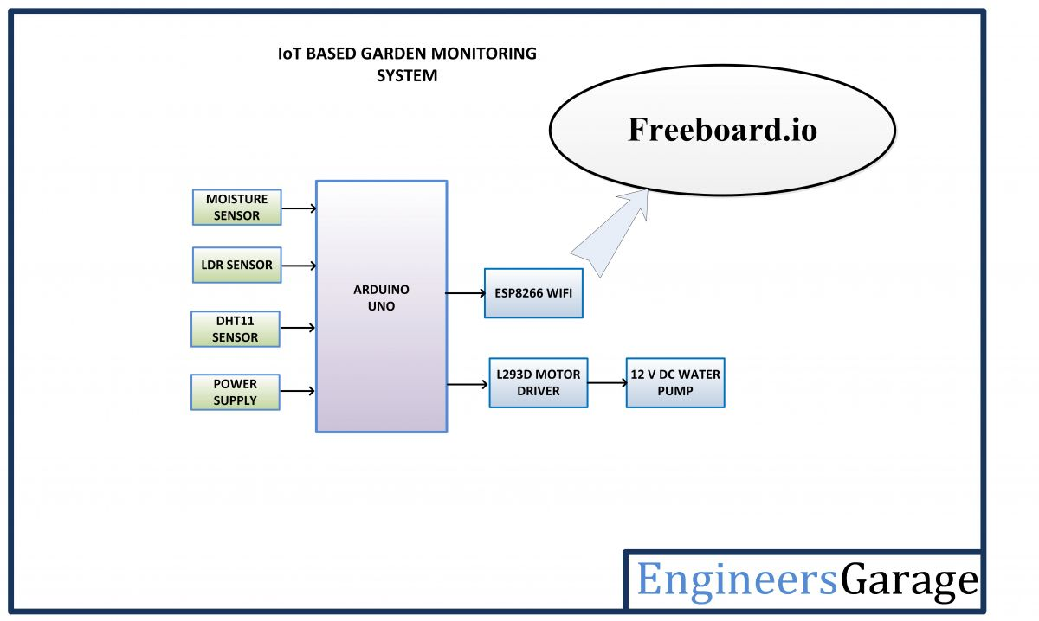
CIRCUIT DIAGRAM
THINGSPEAK.IO
A0
A1
10
11
5v water pump
12

Slide 9
FLOW - CHART

Slide 10
PROPOSED ALGORITHM
We are using a moisture sensor to know when to water the plant. And a water-pump to water the plant. and wi-fi module to monitor the moisture levels and watering.
We are using a microprocessor (Arduino) to manage this whole working model. And a power supply for the Arduino, motor-pump, wi-fi module.
Codes for Arduino and wi-fi module are uploaded and tested using the Arduino software. We can add the sprinkler setup as an extra to conserve more water.
Values will be updated online for monitoring purposes to the thing speak server so that we can later view it as a graphical data
We can also use Drip irrigation, by allowing water to drip slowly to the roots of plants, either from above the soil surface or buried below the surface

Slide 11
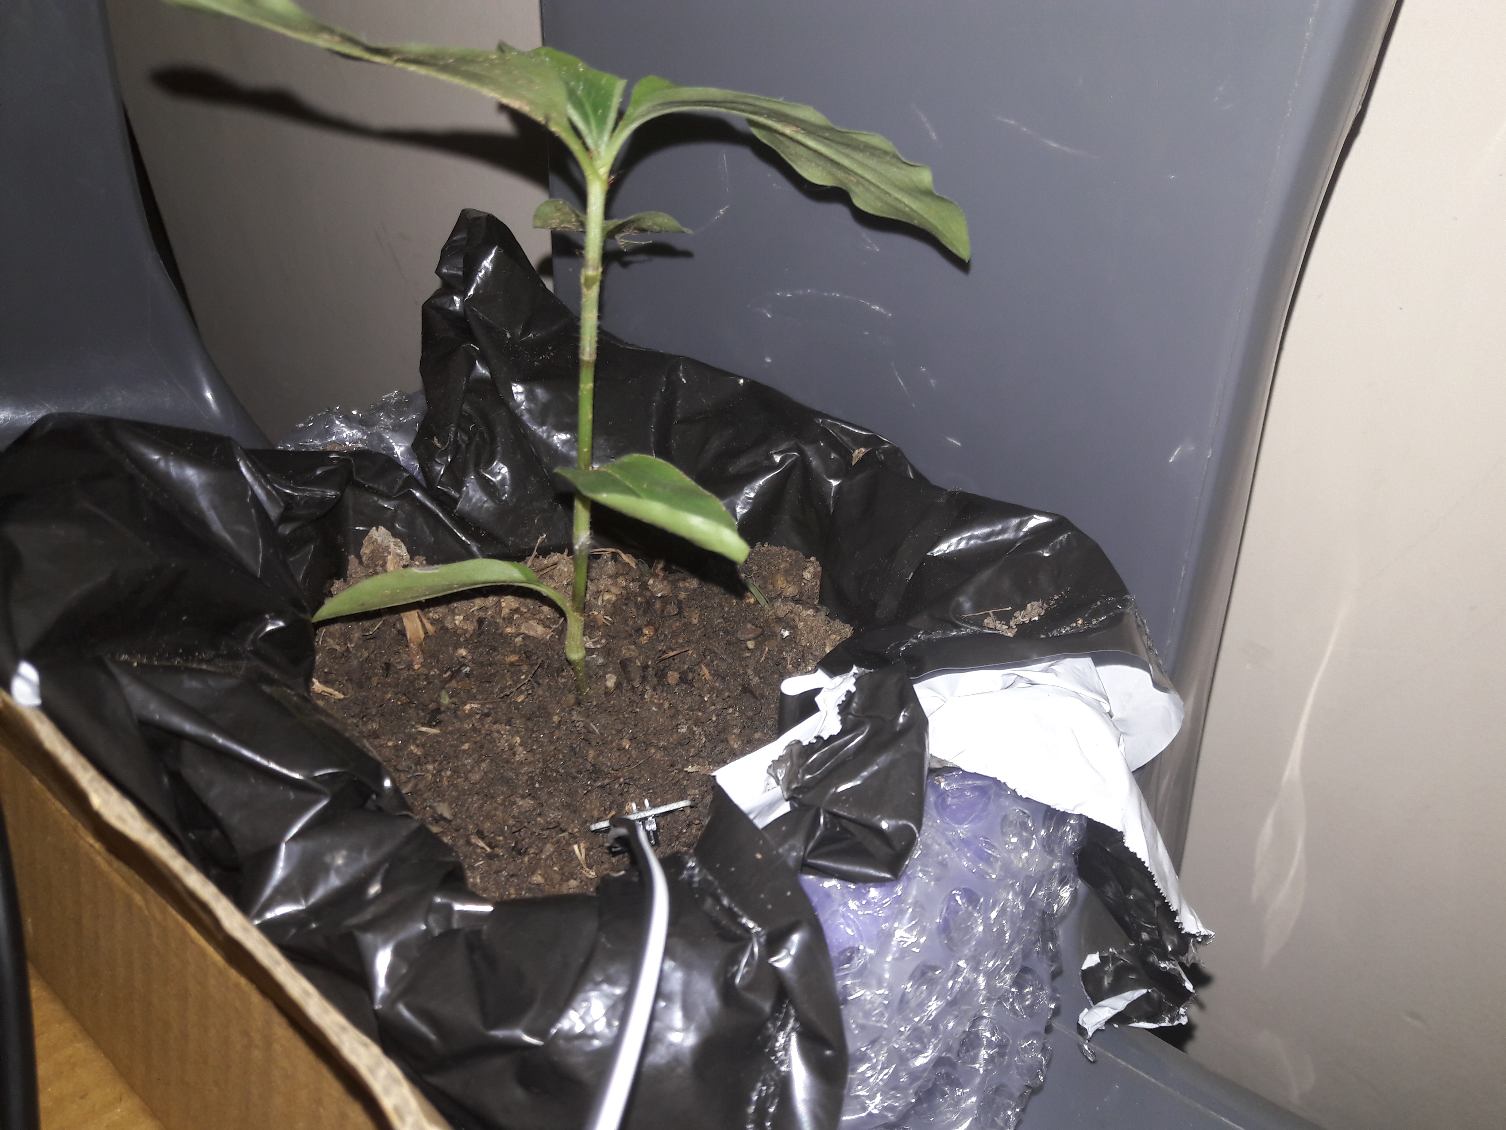
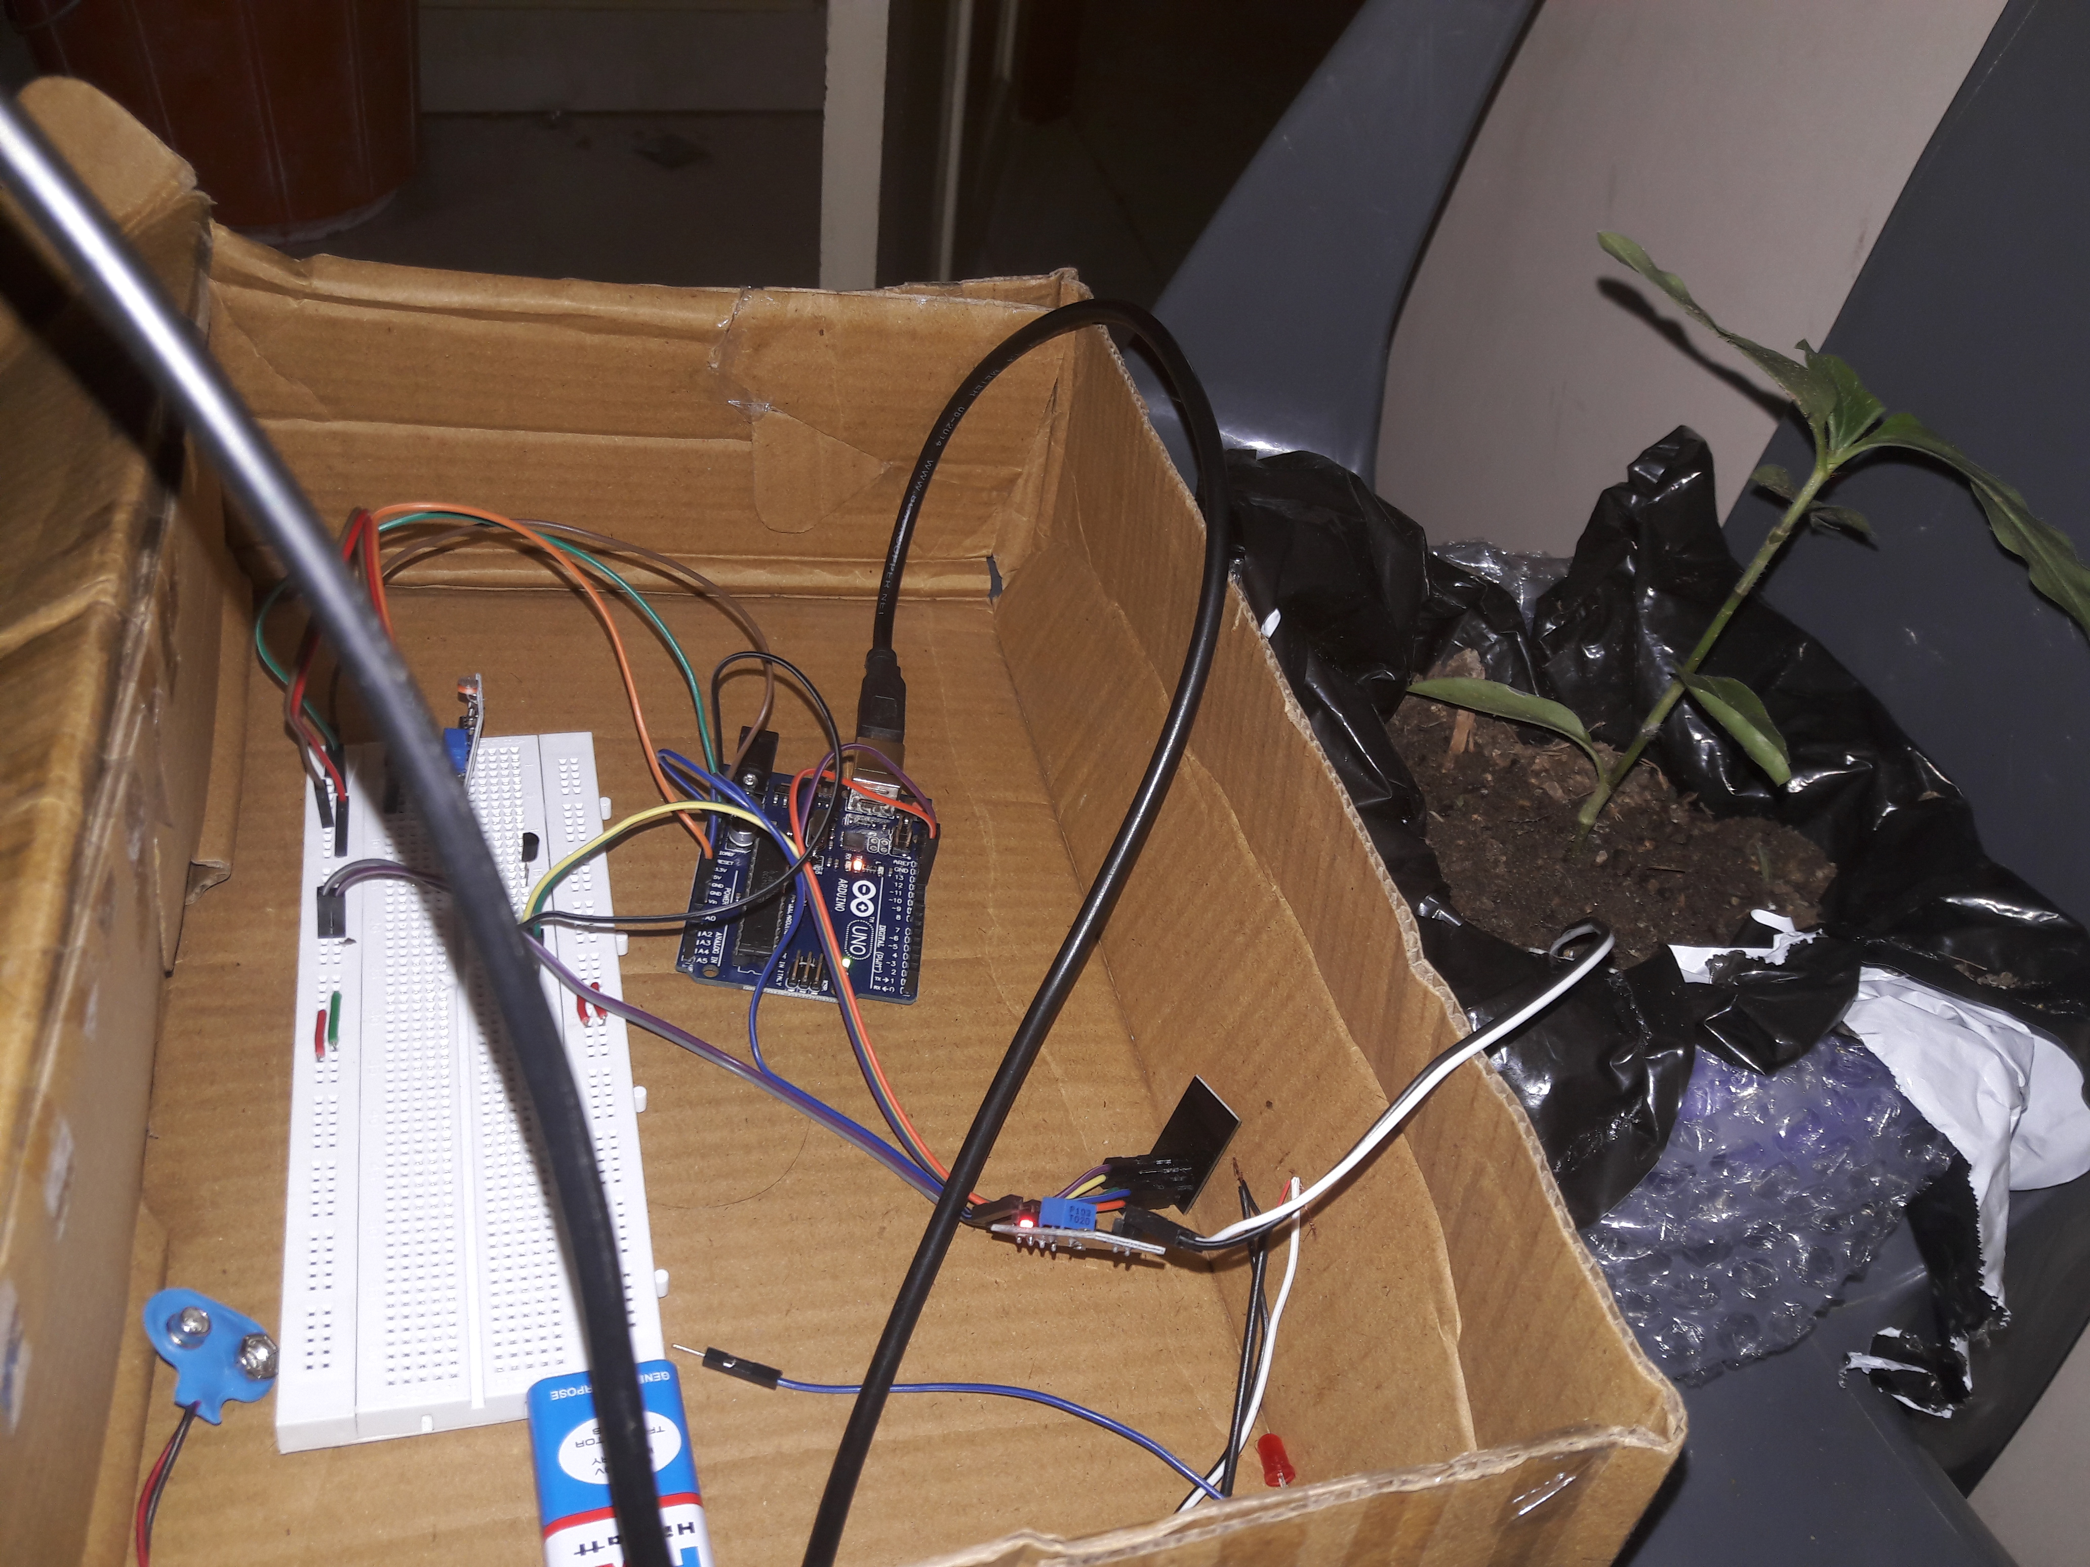
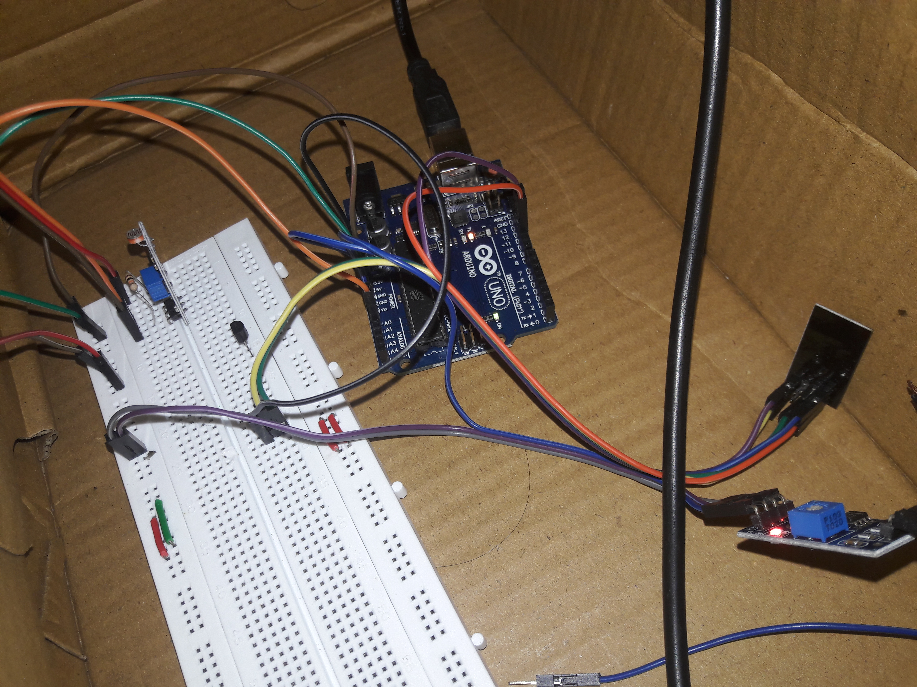
RESULTS

Slide 12
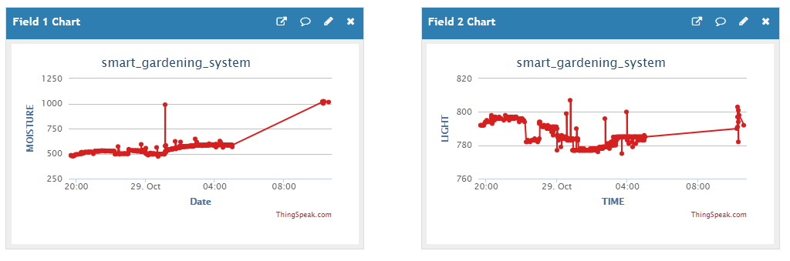
RESULTS
Click here to view the entire graph data that is entered in 10 hours

